Slide 1
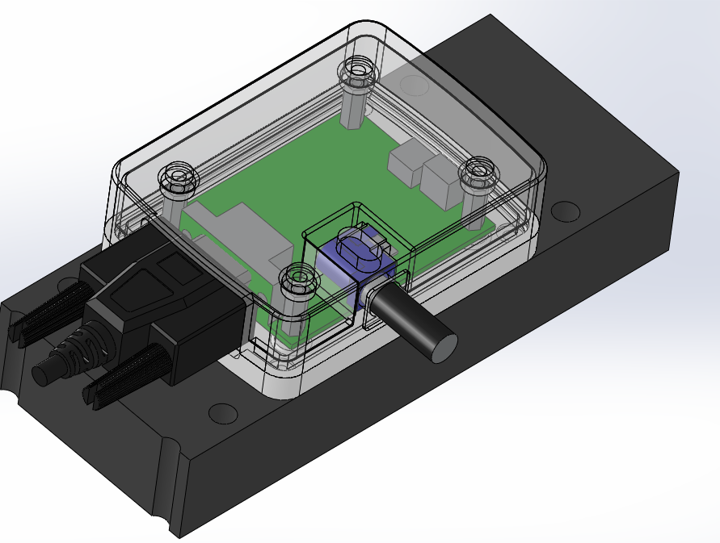

Slide 2
Standoffs (female-female, hex, 4-40 threads, ie mcmaster http://www.mcmaster.com/#female-threaded-hex-standoffs/=oan4dm
All screw holes are clearance for 4-40 screws

Slide 3
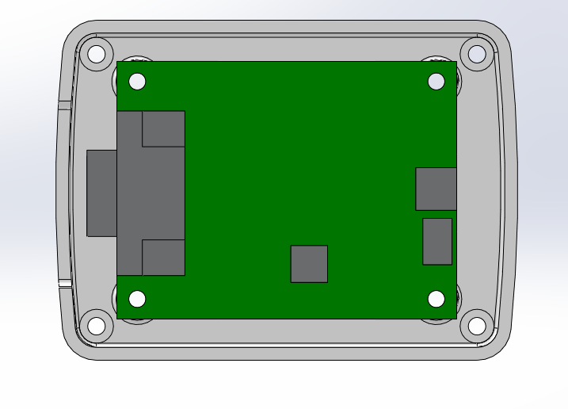
Part is a bit bigger than PCB to make room
For hardware that matches telescope

